Slide 1

Part 5
JavaScript and
HTML Documents

Slide 2
Contents
5.1 JavaScript execution environment
5.2 Document object model
5.3 Element access in JavaScript
5.4 Events and events handling
5.5 Handing events from body elements
5.6 Handing events from button elements
5.7 Handing events from text box and password elements
5.9 Navigator object

Slide 3
5.1 JavaScript Execution Environment(review)
JavaScript is executing in a browser.
The Window object represents the window on the screen where the HTML document is displayed.
It is referred to by window property.
The Document object represents the HTML document being displayed.
It is denoted by the document property of Window.

Slide 4
Contents
5.1 JavaScript execution environment
5.2 Document Object Model
5.3 Element access in JavaScript
5.4 Events and events handling
5.5 Handing events from body elements
5.6 Handing events from button elements
5.7 Handing events from text box and password elements
5.9 Navigator object

Slide 5
5.2 Document Object Model
The DOM is an Application Programming Interface (API) that defines an interface between HTML documents and application programs.
DOM describe an abstract model of how JavaScript interact with HTML documents on different browsers.
Different languages will bind the interfaces to specific implementations.

Slide 6
5.2 Document Object Model
With the DOM, users can write code in programming languages to create documents, move around in their structures, and change, add, or delete elements and their content.
Document in the DOM has a treelike structure.

Slide 7
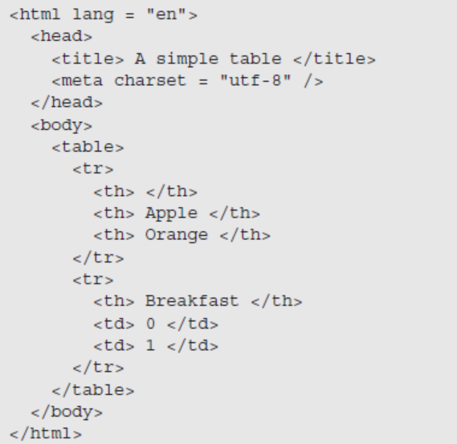
5.2 Document Object Model
The HTML document on page 196 is shown as a conceptual tree.

Slide 8
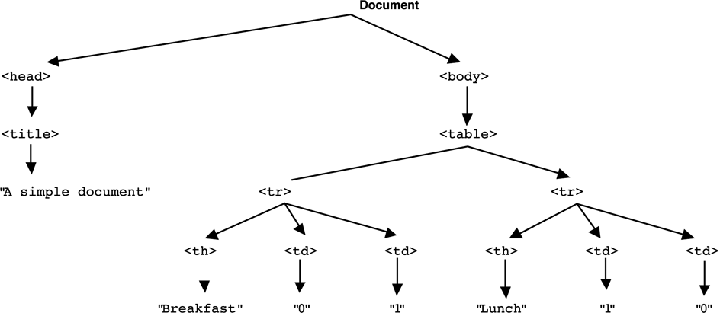
Figure 5.1 The DOM structure example

Slide 9
5.2 Document Object Model
Elements of a document correspond to JavaScript objects.
The JavaScript object has properties and methods.
Attributes of elements become named properties of objects.
<input type=“text” name=“address”>
The JavaScript object representing this node will have two properties
type property will have value “text”
name property will have value “address”

Slide 10
Contents
5.1 JavaScript Execution Environment
5.2 Document Object Model
5.3 Element access in JavaScript
5.4 Events and events handling
5.5 Handing events from body elements
5.6 Handing events from button elements
5.7 Handing events from text box and password elements
5.9 Navigator object

Slide 11
5.3 Element Access in JavaScript
Elements in HTML document correspond to objects in embedded JavaScript script.
Objects can be addressed in four ways:
forms and elements array of the Document object
Individual elements are specified by index
Using the name attributes for the form and its elements
name attribute is required
Using getElementById with id attributes
id attribute value must be unique for an element
Implicit arrays

Slide 12
5.3 Using forms array
The original way is to use the forms and elements arrays of the Document object, which is referenced through the document property of the Window object.
Window is referenced by window.

Slide 13
5.3 Using forms array
Consider this form:
<form action = "">
<input type = "button" name = "pushMe">
</form>
The input element can be referenced as
document.forms[0].elements[0]
The drawback is that the addressing can be changed due to the addition or deletion of elements.

Slide 14
5.3 Using name Attributes
All elements from the referenced element up to, but not including, the body must have a name attribute
Example
<form name = "myForm" action = "">
<input type = "button" name = "pushMe">
</form>
Referencing the input
document.myForm.pushMe

Slide 15
5.3 Using id Attribute
Set the id attribute of the input element
<form action = "">
<input type="button" id=“turnItOn">
</form>
Then use getElementById function
document.getElementById(“turnItOn")
Example dom.html

Slide 16
5.3 Using implicit arrays
For checkbox and radio buttons, they have the same name in one group.
Each group corresponds to one implicit array, which has the same name as the group name.

Slide 17
5.3 Using implicit arrays
In the following, the array of the checkboxes, named vehicles, is the property of the form.
<form id = “vehicleGroup”>
<input type = “checkbox” name = “vehicles”>
value = “car” /> Car
<input type = “checkbox” name = “vehicles”>
value = “truck” /> Truck
<input type = “checkbox” name = “vehicles”>
value = “bike” /> Bike
</form>

Slide 18
5.3 Using implicit arrays
The following code is to detect how many checkboxes are checked.
var numChecked = 0;
var dom = document.getElementById(“vehicleGroup”);
for (index = 0; index < dom.vehicles.length; index+
if (dom.vehicles[index].checked)
numChenked++;

Slide 19
Exercise
Suppose an HTML has a text box and a button.
When you input some words in the text box, show the message with the input words once the button is pressed.
<form id=“myform”>
<input type=“text” id="mytext">
<input type=“button” id="mybutton" onclick="foo()">
</form>
Tips:
using forms(elements) array or getElementById function;
using the value property to get the input words.

Slide 20
Contents
5.1 JavaScript execution environment
5.2 Document Object Model
5.3 Element access in JavaScript
5.4 Events and Events handling
5.5 Handing events from body elements
5.6 Handing events from button elements
5.7 Handing events from text box and password elements
5.9 Navigator object

Slide 21
5.4 Events and Event Handling
Event-driven programming is a style of programming in which pieces of code, event handlers, are written to be activated when certain events occur.
Events represent activity in the environment such as moving the mouse or the completion of the loading of a document, etc.
An event handler is a program segment designed to execute when a certain event occurs.

Slide 22
5.4 Events and Event Handling
Registration is the activity of connecting the event handler to a type of event.
(1) In HTML, assign an event attribute an event handler.
(2) In JavaScript, assign a DOM node an event handler.
The example will be given later.

Slide 23
5.4 Events, Attributes and Tags
Particular events are associated with certain attributes of HTML tags.
The attribute for one kind of event may appear on different tags.

Slide 24
5.4 Events, Attributes and Tags (pp.203)
Event Tag Attribute
blur onblur
change onchange
click onclick
focus onfocus
load onload
mousedown onmousedown
mousemove onmousemove
mouseout onmouseout
mouseover onmouseover
mouseup onmouseup
select onselect
submit onsubmit
unload onunload

Slide 25
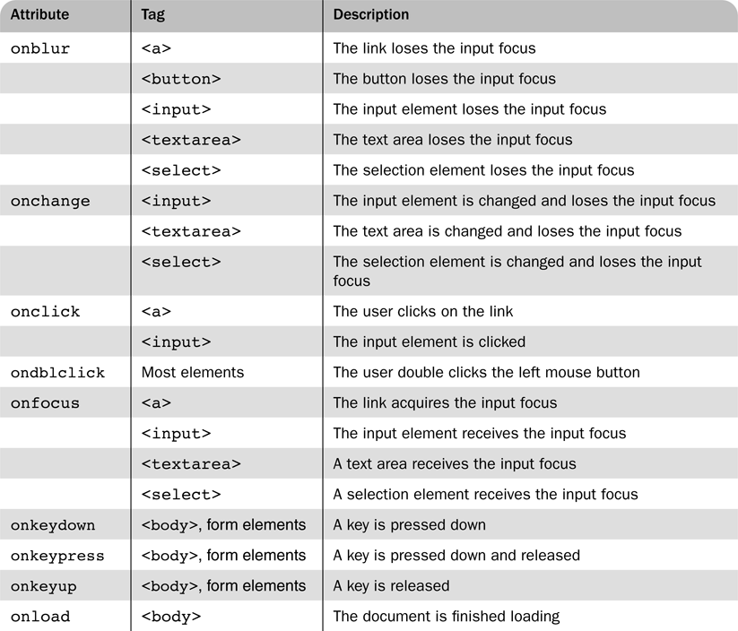
Table 5.2 Event attributes and their tags (pp.204)

Slide 26
5.4 Registering a Handler
Assigning the event handler script to an event tag attribute:
<input type=“button” name=“myButton”
onclick=
“alert(‘You clicked the button!’)”/>
A function call can be used if the handler is longer than a single statement
<input type=“button” name=“myButton”
onclick=“myHandler()”/>

Slide 27
5.5 Handling Events from Body Elements
See the load.html example(pp.206)
This example illustrates when the page is loaded into main memory.
The unload event is probably more useful

Slide 28
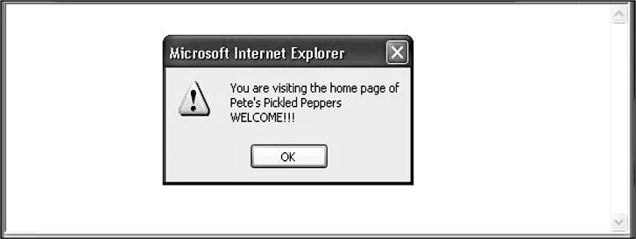
Figure 5.2 Display of load.html

Slide 29
5.4 Registering a Handler
An event handler function could also be registered by assigning its name to the associated event property of corresponding JavaScript object, as in the following example:
document.getElementById("myButton").onclick =
myButtonHandler;
Notice that only the name of the handler function is assigned to the property—it is neither a string nor a call to the function.

Slide 30
5.6 Handling Events from Button Elements
An event can be registered for this tag in two ways.
<input type=“button” name=“freeOffer” id=“freeButton”/>
(1)Using an event attribute in HTML
<input type=“button” name=“freeOffer”
id=“freeButton” onclick=“freebuttonHandler()”/>
(2)Assigning function names to a property of the element node in JavaScript
document.getElementById(“freeButton”).onclick =
freeButtonHandler;
Note that the function name, a reference to the function, is assigned.

Slide 31
5.6 Checkboxes and Radio Buttons
The following examples show two different methods for registration.
Example radio_click.html (pp.207)illustrates a script that displays an alert when a radio button is clicked.
Note: A parameter is passed to the handler function.
In example radio_click2.html (pp.210), a reference to the handler function is assigned to the onclick property of each element node in JavaScript.
Note: no parameters are passed to the function when it is called by the JavaScript. The handler code must identify the element that caused the call.

Slide 32
Exercise (total.html)
Develop an HTML document that has checkboxes for apple(59 cents each), orange(49 cents each), and banana(39 cents each), along with a Submit button.
Each of the checkboxes should have its own onclick event handler. These handler add the corresponding cost of each fruit to a total cost variable totalcost.
When the submit button is pressed, the message “Your total cost is $xxx” is shown (Tips: using alert).

Slide 33
5.6 Comparing Registration Methods
Assigning to an attribute of HTML element is more flexible, allowing passing parameters during calling functions.
Assigning to a node property helps separate HTML and the JavaScript code.

Slide 34
5.7 Handling Events from Text Box and Password Elements
Text boxes correspond to four different events: blur, focus, change and select.
Example nochange.html illustrates ‘blurring’ a field whenever it gains focus (pp.213).
By manipulating the focus event, the user is prevented from changing the amount in the input box.

Slide 35
5.7 Validating Form Input
Checking the format and completeness of input is a common application of JavaScript.
Advantages:
Validating data using JavaScript provides quicker interaction for the user.
In contrast, validity checking on the server requires a round-trip for the server to check the data and then to respond with an appropriate error page.

Slide 36
5.7 Validating Form Input
Example pswd_chk.html illustrates validity checking (pp.216).

Slide 37
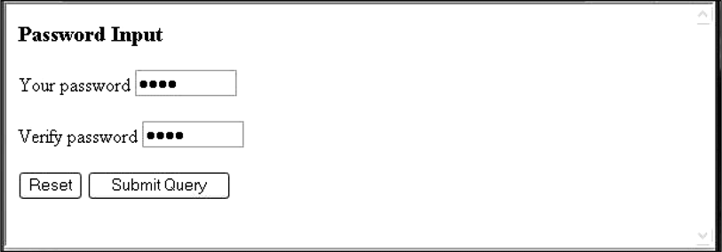
Figure 5.5 Display of pswd_chk.html after it has been filled out.

Slide 38
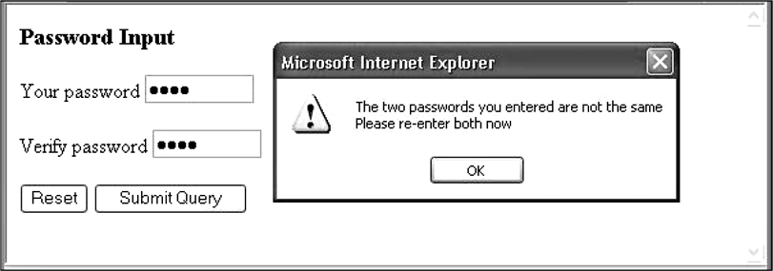
Figure 5.6 Display of pswd_chk.html after Submit Query has been clicked

Slide 39
Contents
5.1 JavaScript Execution Environment
5.2 Document Object Model
5.3 Element Access in JavaScript
5.4 Events and Events handling
5.5 Handing events from body elements
5.6 Handing events from button elements
5.7 Handing events from text box and password elements
5.9 Navigator object

Slide 40
5.10 The navigator Object
Properties of the navigator object allow the script to determine characteristics of the browser in which the script is executing.
The appName property gives the name of the browser.
The appVersion gives the browser version.
Example navigate.html (pp.232)

Slide 41
Summay
1 Environment
2 DOM model
3 How to access elements
4 Event handling
5 navigator object

Slide 42
Homework
Develop an HTML document that collects the following information from the user:last name, first name,middle intial, age(restricted to be greater than 17), and weight (restricted to the range of 80-300). You must have event handler for the submit button.
Message in alert window must be produced when errors are detected.
Exercises 5.1 (pp.237)

